Slide 1
Parking Proposal
Presented at the Faculty Senate
February 2, 2016

Slide 2
Parking—Benefit or Tax?
1. Parking is a tax
Applied to everyone who comes to UMKC, either as a student or an employee—
This is the status quo.
2. Parking is a benefit
Provided to the members of the UMKC ‘family’
Can this be the new ‘status quo’???

Slide 3
As a Benefit…
According to the Mission and Vision of the University and its Strategic plan as reiterated often by the Chancellor and the Provost, at UMKC we want/need to:
Create a vibrant learning and campus life experience.
Create a supportive campus environment
Promote community engagement, on campus and off
Increase morale: The UMKC COACHE survey results showed low morale among employees; low results with regard to personal and family policies; very low results regarding salary, etc.

Slide 4
Parking as a tax over the years—the status quo
Max Min
30+ yrs $15K $ 9K
25-29 yrs $13K $ 8K
20-24 yrs $12K $ 7K
15-19 yrs $10K $ 5K
10-14 yrs $ 7K $ 4K
How can we turn this parking tax into a benefit?

Slide 5
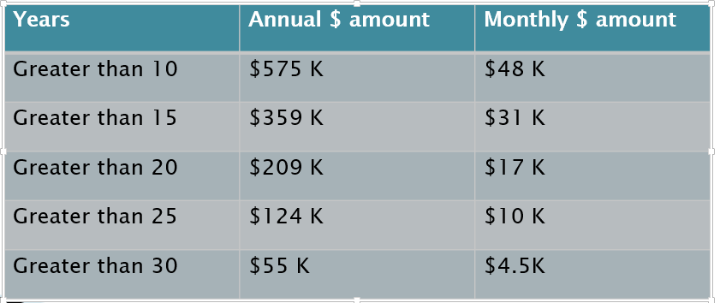
What if we eliminated permit fees altogether for certain groups?
How much is needed if permits fees were eliminated for employees based upon years of service? See Table
Not financially feasible. What else can we do?

Slide 6
Options to recoup lost revenue in order to provide parking as a benefit:
* Increase parking violation fee
* Increase permit fees for employees
* Increase permit fees for students
* A combination of all three of these
The analysis shows that a combination of all of the above options could work best.

Slide 7
Recommendations
Recommendation #1: Increase violation fee by $10, from $25 to $35. By doing so, we could immediately eliminate parking permit fees for those employees here 30 or more years.
If we wanted to benefit more employees, it would take a slight increase in permit fees, thus recommendation 2.

Slide 8
Recommendations–-cont.
Recommendation 2: In addition to the increase in violations by $10, increase monthly parking fees by $.97 for all students and employees who have not yet achieved 20 years of service.
In other words, eliminate the parking fee for all employees with 20 years of service or more.

Slide 9
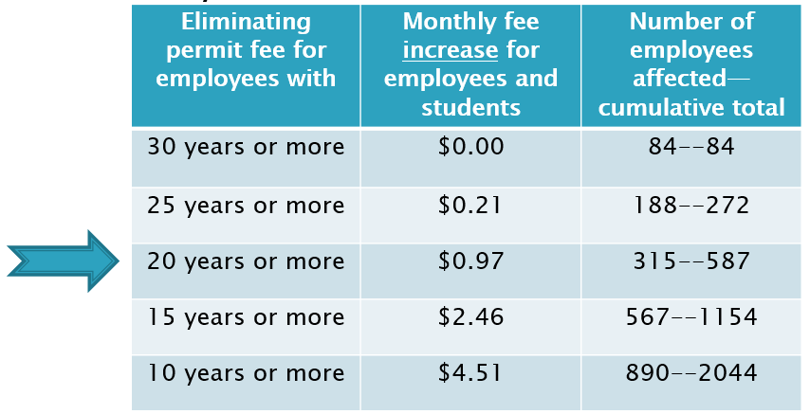
Options assuming some employees and all students are paying for permits and violations are up by $10
Monthly:

Slide 10
What Next? Two-Step Process
Step One: Petition the Chancellor:
Increase the parking violation fine by $10.
This does NOT require Curator Board Approval
This would immediately benefit those employees with 30 years+ service
Step Two: Formally propose fee increase of $0.97 or $1
This DOES require Curator Board Approval
This would benefit those employees with 20 years+ service
MOTION TO PROCEED?

